Slide 1


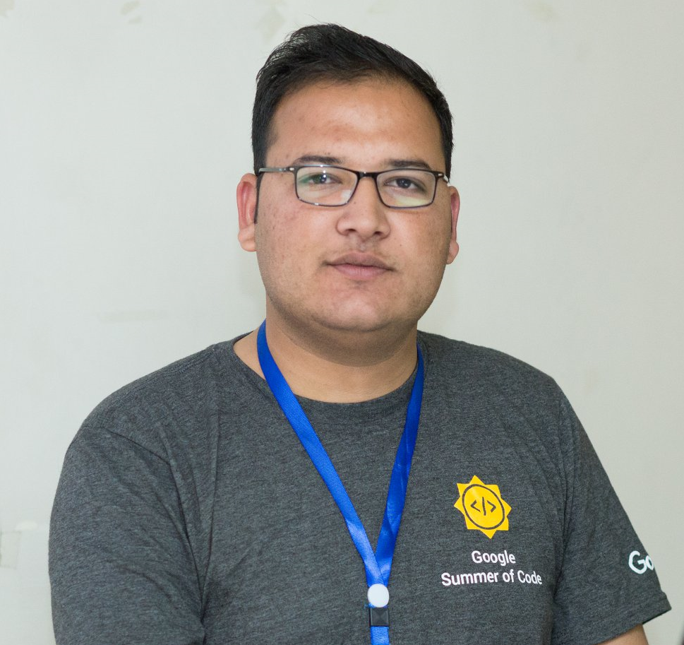
Google Summer of Code
Information Session
Noor Binte Amir
GSoC Scholar 2019 WTM Scholar 2019
Tahir Ramzan
GSoC Scholar 2015 and 2016
GCI Mentor 2018 and 2019

Slide 2
Now Presenting…
Noor Binte Amir

Slide 3
About Me
Noor Binte Amir
Final Year Student at NUST H-12 Google Summer of Code Intern 2019 Google Women Techmakers Scholar 2019 Winner of HackACM 2019 Game Development Project Lead at CRIMSON

Slide 4

What is GSoC
Brief Introduction
Google Summer of Code is a program designed to encourage university students participation in open source software development. Students work with an open source organization on a 3 month programming project.

Slide 5
Why Participate
Perks
3000USD Stipend for Pakistan
Google tag for your resume
Real-world software development skills
Useful contacts worldwide
One time referral for interview at Google
Gateway for big opportunities and events

Slide 6
Eligibility
Aged 18 or over
Enrolled in University during proposal period

Slide 7
Skills Required
Interest in learning to code
Dedication
No prior coding skills necessary

Slide 8
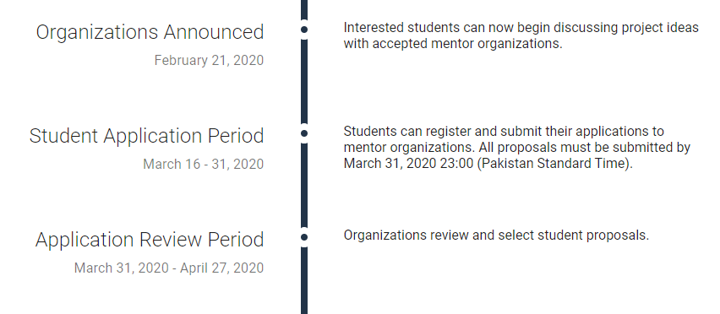
Timeline

Slide 9
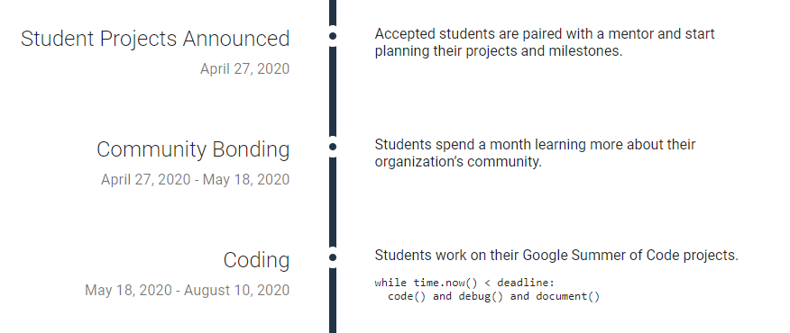
Timeline

Slide 10
Application Procedure
Choose your project and organization (upto 3)
Contribute to organization (fix typos, minor bugs, add features)
Write proposal for chosen project
Get proposal reviewed by mentors
Submit proposal, proof of enrollment

Slide 11

First Stop
QUORA
Go through procedure, perks and experiences of past students

Slide 12

Second Stop
MEDIUM
Learn from experiences of past students

Slide 13
Third: Getting Started
GSOC SITE
summerofcode.withgoogle.com
Review timeline
Read student guides and FAQ
Shortlist organizations and projects

Slide 14
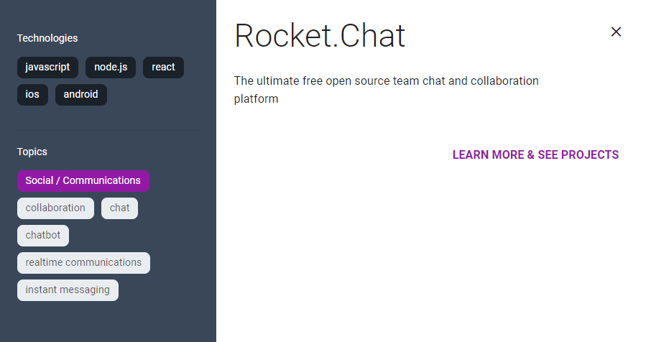

Slide 15
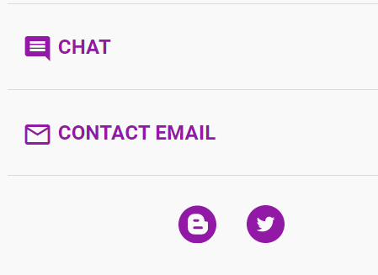
Fourth
MAKING CONTACT
Scout all contact options
Email mentors to show interest asap
Ask for advice and tips
Show enthusiasm
Find chat forums

Slide 16
Fifth
ANALYZE
Shortlist active organizations
Determine competition
Number of gsoc students interested
Read chats
Check number of contributing students on github
Ask mentor how you can one up the competition
Download and Install softwares

Slide 17
Sixth
WRITING PROPOSAL
Ask mentor for guidelines
Focus on presentation
Refer to proposals by past selected students
Bookmark a list of tutorials

Slide 18
ABSTRACT
Why you chose this project
What you are passionate about
Your skills and experience
How you would be a useful addition to the community
Talk about your projects that solve problems

Slide 19
CURRENT ISSUES
Highlight current issues with the software
Issues might be unrelated
Your observations regarding the software

Slide 20
PROPOSED SOLUTIONS
Solutions to issues raised
How the user experience will be affected by your solution
You don’t have to implement all of them.

Slide 21
PROPOSED ENHANCEMENTS
Small features and additions that will improve your project

Slide 22
TIMELINE
Phase | Dates | Task | Difficulty Level
Application Review Period | April 10 - May 6 | Jump into the community and add contributions, raise issues and fix them. | Easy
Community Bonding | May 6 - May 27 | Explore the community. Understand the codebase. Identify organization best practices. Get more proficient with Kotlin. | Easy
Milestone 1 : May 27, 2019 - June 24, 2019
Week 1 | May 27 - June 2 | Set up core functionality of pluggable themes. | Hard
Week 2 | June 3 - June 9 | Set up core functionality of pluggable themes. (Continued) | Hard
Week 3 | June 10 - June 16 | Create three beautiful dark themes. | Intermediate
Week 4 | June 17 - June 23 | UI/UX enhancement. | Intermediate
-- | June 24 - June 28 | 1st Evaluation Period | --

Slide 23
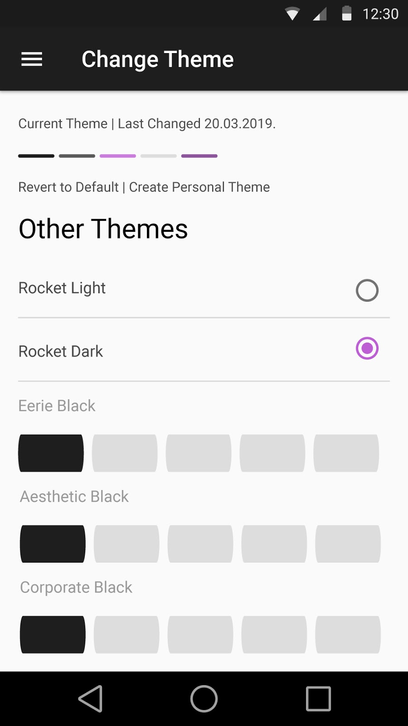
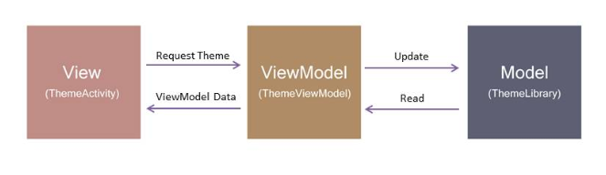
DETAILED BREAKDOWN
Explain points. You can have learning periods
Use diagrams where possible
Use mockups
Use code snippets

Slide 24
OTHER TIPS
Highlight strengths you have
Offer documentation

Slide 25
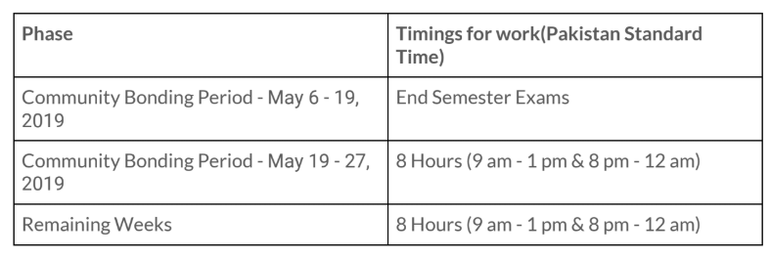
TIME COMMITMENT AND COMMUNICATION
Dedicate 8 hours
Suggest biweekly video calls
Highlight busy periods

Slide 26
FUTURE PLANS
For yourself and your organization
BACKGROUND
About yourself
What you like to invest time in

Slide 27
Writing Proposal
DEMO

Slide 28
Get your proposal reviewed!

Slide 29

Final Step
GITHUB
Fix typos, bugs and add features

Slide 30
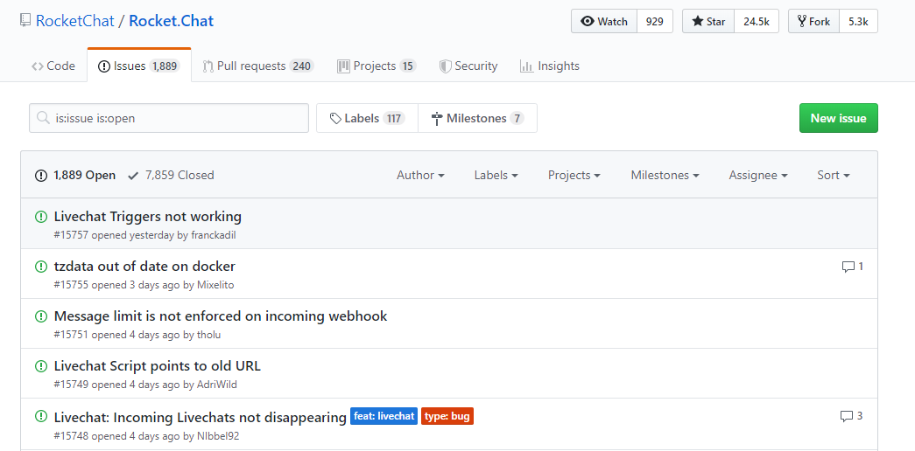

Slide 31
Keep in touch with your mentor!

Slide 32
Stay active during application review period!

Slide 33


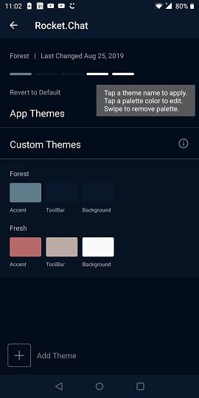
My Internship Experience
Helpful mentors
Confidence in working on collaborative projects
Improved approach towards writing code
Comprehensive skill development

Slide 34
Outcomes and Opportunities
Mentorship Opportunity
STIPEND
Cool Google T-shirt
Further opportunities like WTM
Job and internship preference
Speaking at notable events like DevFest
Collaborations

Slide 35
Thank You!
Noor Binte Amir
GSoC Scholar 2019 WTM Scholar 2019

